Slide 1






A functional reference architecture to accelerate open-source development of power system applications
LF Energy FAWG Meeting
25 April 2022
Sean Crimmins, EPRI
Laura Crowley, EPRI
Jonas van den Bogaard, Alliander
Benoit Jeanson, RTE
Notes:
Introduction story… the last year
EPRI ref arch
FAWG
Paris

Slide 2
Agenda
Motivation for building a reference architecture
ArchiMate primer
Model demo:
Metamodel
Generic reference architecture
LF Energy projects views:
OpenSTEF
SOGNO
PowSyBl
Collaborative modelling with Archi and GitHub
Feedback and next steps
Notes:
What we’d like you to get out of this is the value that a reference architecture that combines functions, data and exchange standards can provide.
We’d especially like to know if that value is enough to collaborate on this work as a team and, if so, what should be our next targets?

Slide 3
Benefits of the reference architecture for open-source development & LF Energy
Engage stakeholders in LF Energy’s open-source projects
Communicates the purpose and scope of an LF Energy projects
Facilitate systems integration
Communicates the data objects that are exchanged between software
Facilitate interoperability
Data exchange standards
Create alignment within the LF Energy open-source community
Identifies gaps and overlaps in the portfolio of projects
Allow utilities to align/compare their strategic development with the LF energy portfolio
Notes:
Sean

Slide 4
What is a Reference Architecture
A few definitions:
“A reference architecture … provides a template solution for an architecture for a particular domain. It also provides a common vocabulary with which to discuss implementations ” Wikipedia
“Reference Architectures are standardized architectures that provide a frame of reference for a vertical domain or sector. Reference models or architectures provide a common vocabulary, reusable designs, and industry best practices. ” LeanIX
More than just software
Business Architectures
Business Practices
Application
Technology
Notes:
Sean
Specify the use of data exchange standards.
Combine high-level views of the system with detailed descriptions of the application (e.g. contingency analysis).
Have the high level view and you can drill down if you want
Specifying common definitions of functions within the control centre.

Slide 5
What is a Functional Reference Architecture
A reference architecture:
Defines the functions and data required to implement a capability independent of applications and technology
Provides a vocabulary and definitions that enable:
Planning and roadmapping in terms of functional components without committing to a particular application
Requirements analysis while delaying design, deployment and purchasing decisions
Analysis of possible implementation options and a modularization of complex application suites.
Identification of data exchanges between application components and the corresponding standards.
Notes:
Sean
Specify the use of data exchange standards.
Combine high-level views of the system with detailed descriptions of the application (e.g. contingency analysis).
Have the high level view and you can drill down if you want
Specifying common definitions of functions within the control centre.

Slide 6
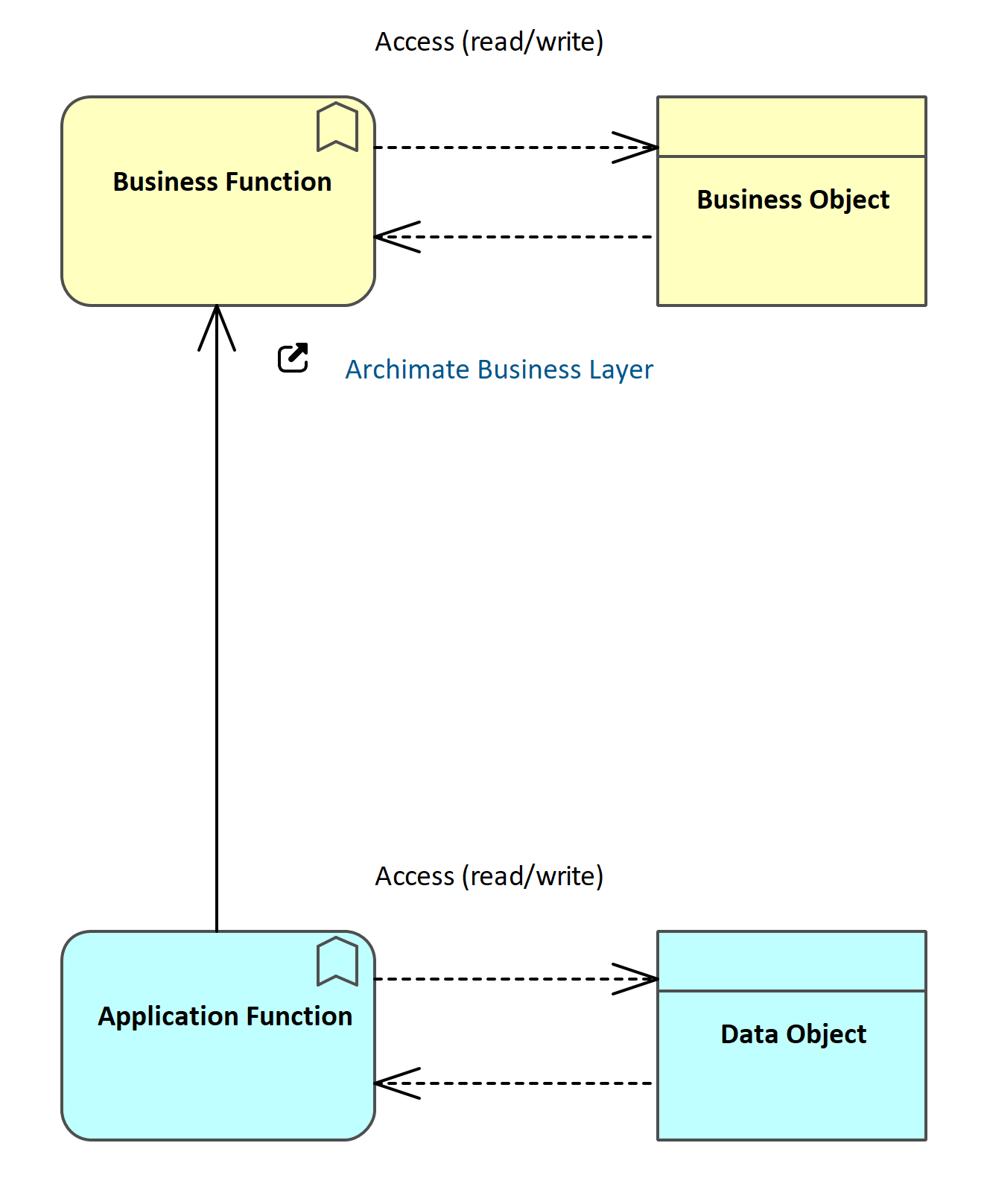
ArchiMate primer
The ArchiMate framework separates the Business layer from the Application layer¹.
An Application Function represents automated behavior that can be performed by an application component.
A data object represents data structured for automated processing.
A data object can be accessed by an application function.
ArchiMate is framework that is implemented in the Enterprise Architect software.
¹ https://pubs.opengroup.org/architecture/archimate3-doc/chap09.html
Notes:
Laura
There is more functionality to both ArchiMate and EA but these are the parts that are relevant to this project.

Slide 7
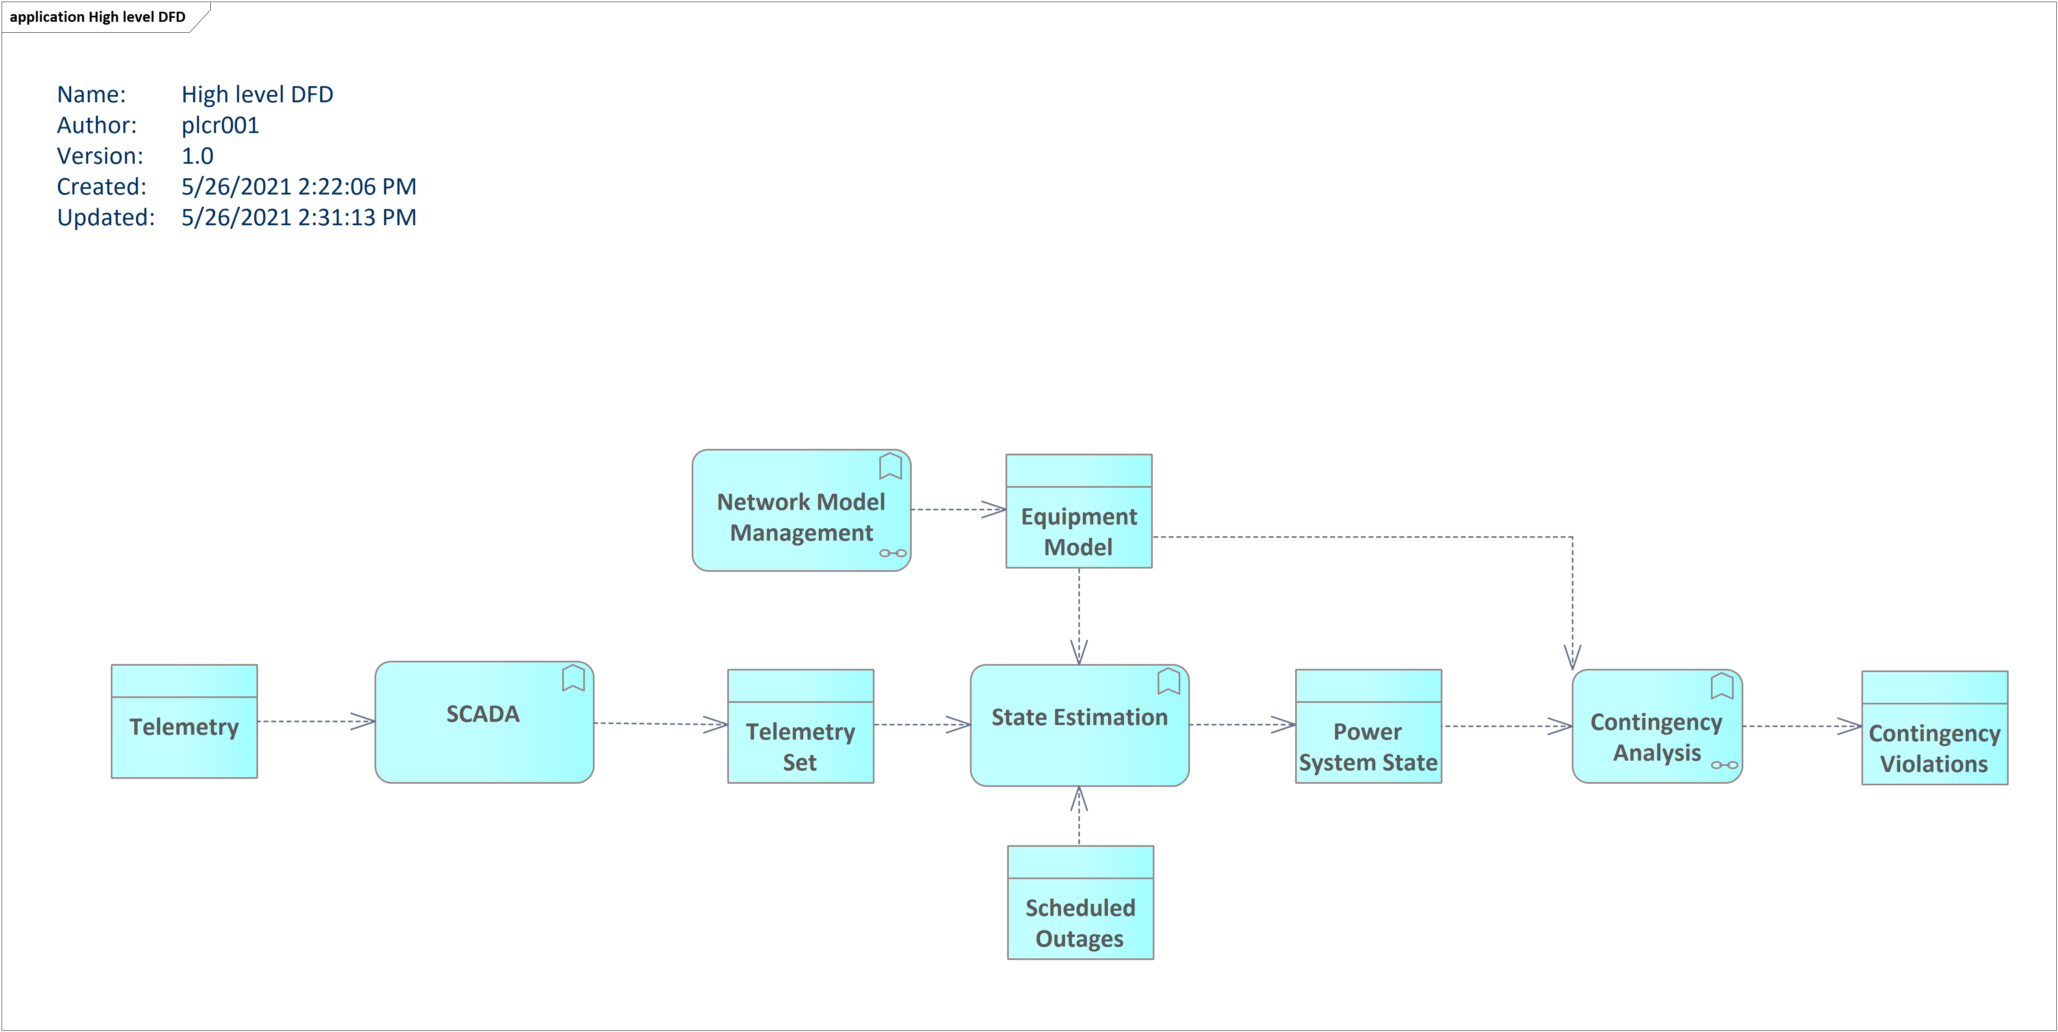
Reading the reference architecture A small example of SCADA and State Estimation
Application functions
Data objects
SCADA and State Estimation are application functions.
Telemetry is a data object and is an input to the SCADA application function.
The Telemetry Set is an output of the SCADA application function.
Notes:
Laura

Slide 8
High Level overview of the reference architecture
Notes:
Laura

Slide 9
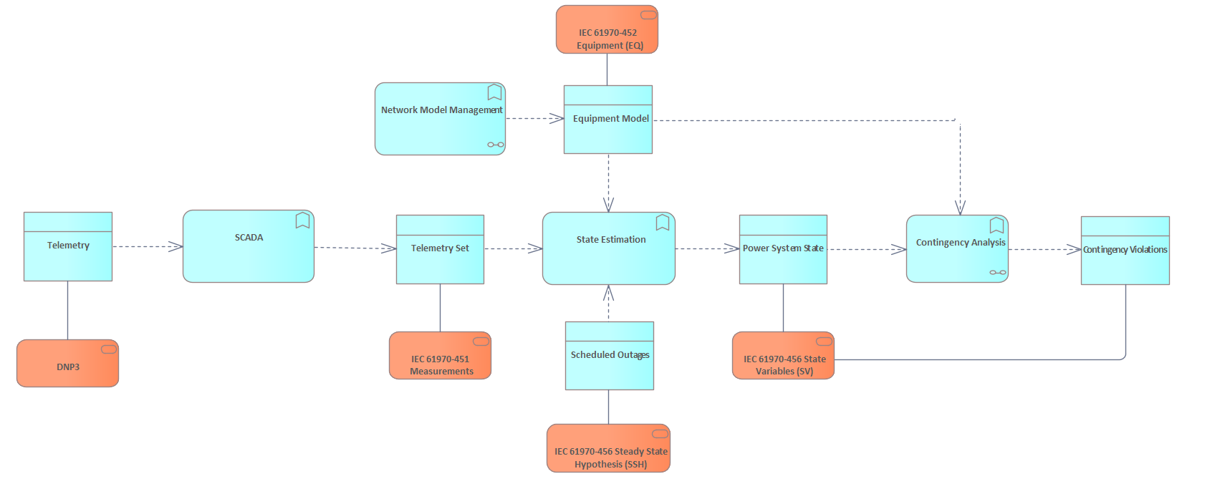
Data Exchange Standards
¹
Notes:
Laura
For example, IEC 61970-452:2017 defines the subset of classes, class attributes, and roles from the CIM necessary to execute state estimation and power flow applications. https://webstore.iec.ch/publication/30444

Slide 10
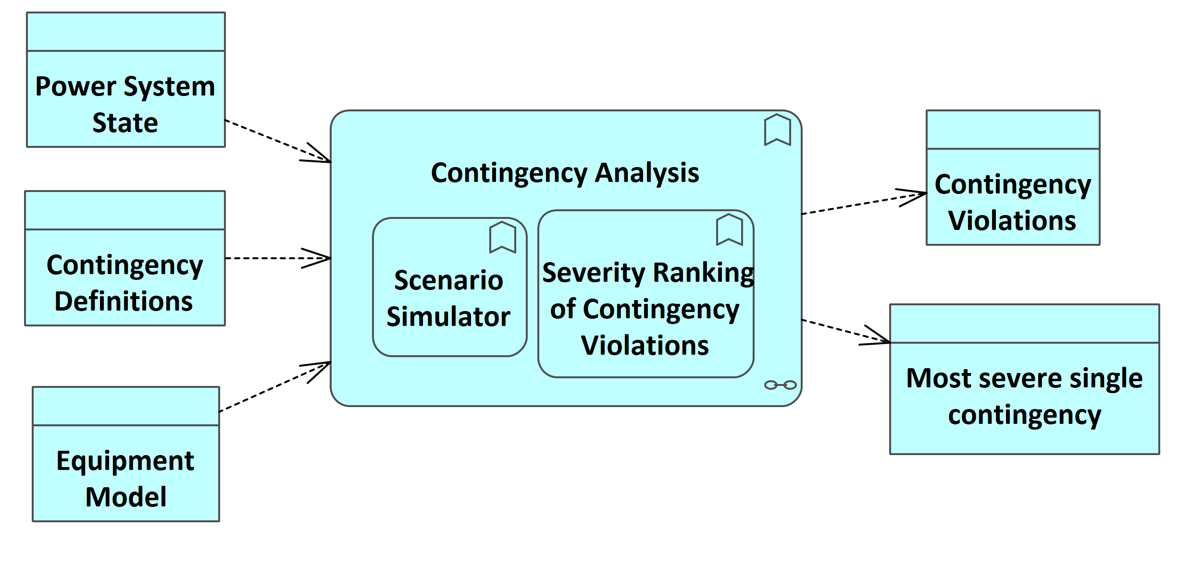
Contingency Analysis – a closer look
Notes:
Laura
Trying to re-use definitions as much as possible. This definition is from EPRI Smart Grid repository.https://smartgrid.epri.com/UseCases/ContingencyAnalysis-Baseline.pdf
In layman's terms, Contingency Analysis (CA) is a "what if" scenario simulator that evaluates, provides and Contingency Analysis is essentially a "preview" analysis tool. It simulates and quantifies the results of problems that could occur in the power system in the immediate future. It prioritizes the impacts on an electric power system when problems occur. A contingency is the loss or failure of a small part of the power system (e.g. a transmission line), or the loss/failure of individual equipment such as a generator or transformer.
Contingency analysis is an application function that uses a simulated model of the power system, to:
evaluate the effects, and
calculate any overloads,
resulting from each contingency.
CA is used as a study tool for the off-line analysis of contingency events, and as an on-line tool to show operators what would be the effects of future outages. This allows operators to be better prepared to react to outages by using pre-planned recovery scenarios.

Slide 11
Model demo
All models are licenced under Creative Commons Attribution 4.0 International License
Metamodel
Generic reference architecture
LF Energy projects views:
OpenSTEF
SOGNO
PowSyBl
Collaborative modelling with Archi and GitHub
Notes:
Metamodel (Laura)
Generic reference architecture (Laura – short term forecasting)
LF Energy projects views:
OpenSTEF (Jonas)
SOGNO (Jonas)
PowSyBl (Benoit)
Collaborative modelling with Archi and GitHub (Benoit)

Slide 12
Next Steps
We have modelled 3 LFEnergy projects; PowSyBl, SOGNO, OpenSTEF
Is this collaborative approach useful?
Who wants to be involved?
What are the most critical domains?
Extend the reference architecture to demonstrate technical services (e.g., messaging, gateway, ESB)
Present at the TAC
GitHub: https://github.com/lfenergyarchitecturemodel
Slack: https://lfenergy.slack.com/archives/C03A1U5APPA
Notes:
Jonas

Slide 13
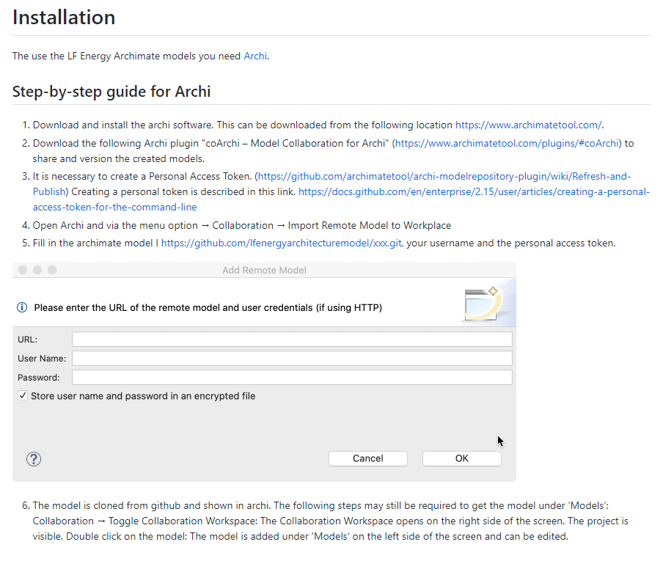
Appendix A: LF Energy Architecture Model installation

Slide 14
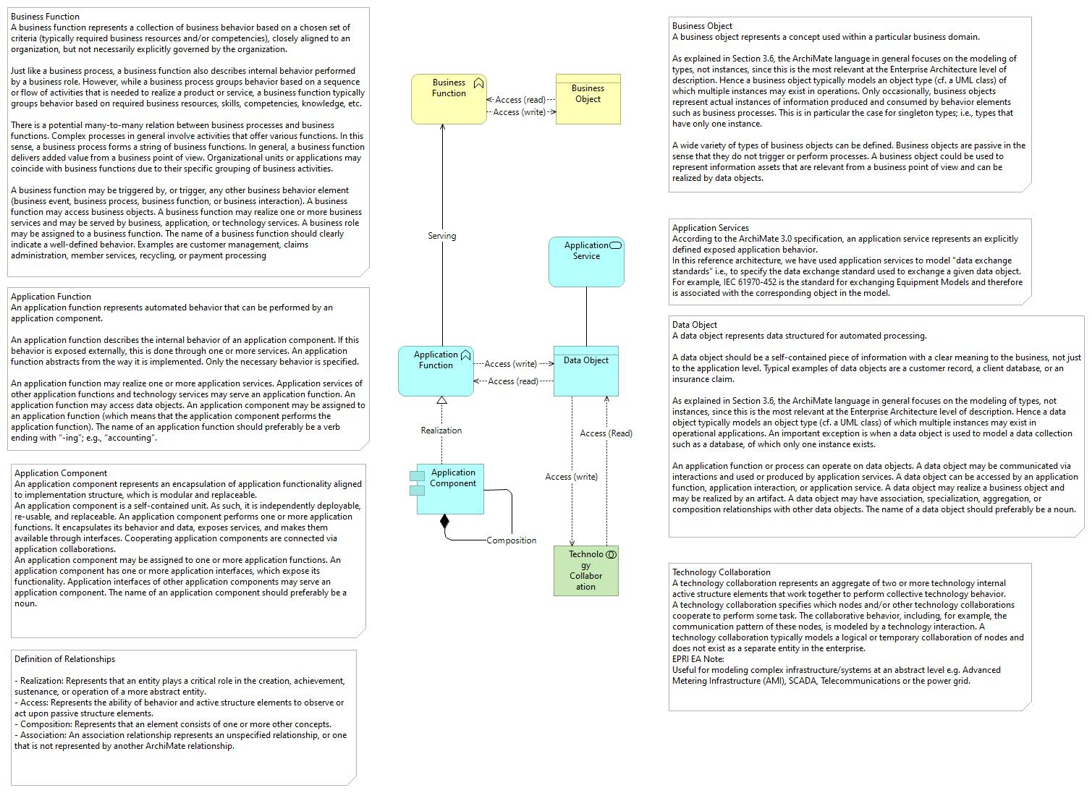
Appendix B: LF Energy Architecture Metamodel

Slide 15
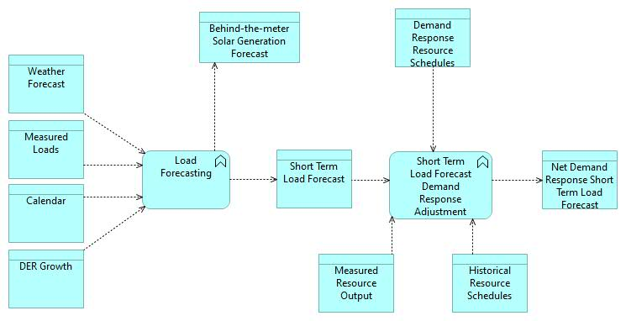
Appendix C: LF Energy Architecture Model – Generic reference architecture

Slide 16
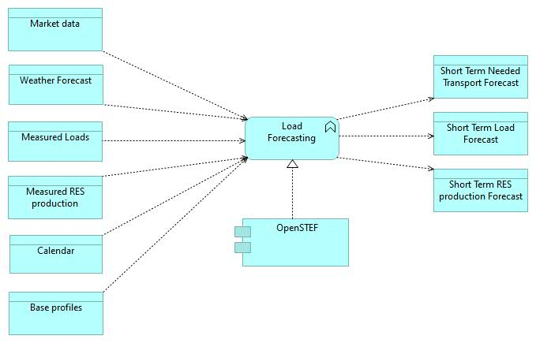
Appendix C: LF Energy Architecture Model - OpenSTEF

Slide 17
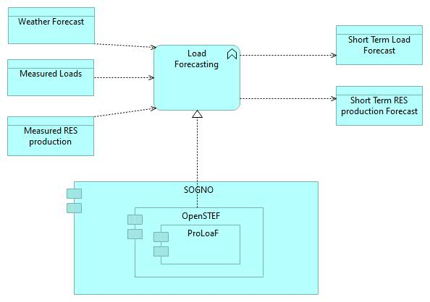
Appendix C: LF Energy Architecture Model - SONGO

Slide 18
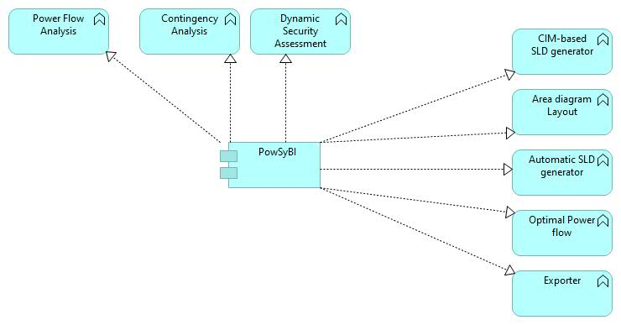
Appendix C: LF Energy Architecture Model - PowSyBI

Slide 19
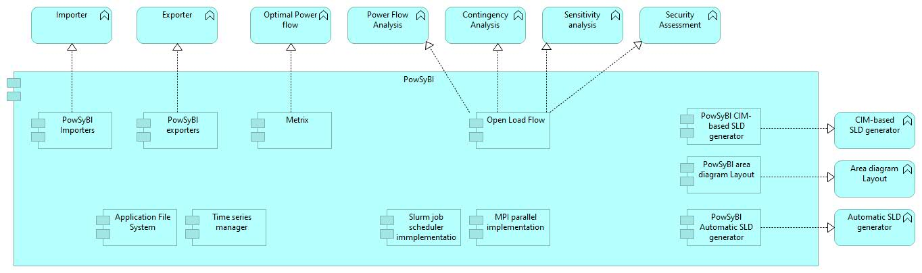
Appendix C: LF Energy Architecture Model - PowSyBI

Slide 20
Appendix B: LF Energy Architecture Model
Placeholder for model images – export from Archi

Slide 21

ABOUT US
Founded in 1972, EPRI is the world's preeminent independent, non-profit energy research and development organization, with offices around the world. EPRI's trusted experts collaborate with more than 450 companies in 45 countries, driving innovation to ensure the public has clean, safe, reliable, affordable, and equitable access to electricity across the globe. Together, we are shaping the future of energy.

Slide 22

Vision
To be a world leader in advancing science and technology solutions for a clean energy future
Mission
Advancing safe, reliable, affordable, and clean energy for society through global collaboration, science and technology innovation, and applied research.
Together…Shaping the Future of Energy™

Slide 23
Notes:
Feedback and next steps...
discussion

